Slide 1
Instructions for use of this
Slide Deck by JE Dunn personnel
The following slides are a template for use by JE Dunn safety or site personnel to conduct a verbal / online discussion about our general approach
Most are self-explanatory – but if you have a question on what a slide means, contact your safety representative
The slides can be used “as-is” – or you can edit them to match your project specifics
A longer, written Site Plan document exists and can be sent subsequently
Remove this instruction slide before presenting!!

Slide 2
Coronavirus Preparedness
Site Plan

Slide 3
Agenda
Confirmed/Suspected Case Update
General Requirements (Emphasis on Social Distancing)
Site Status and Travel Updates
Site Entry/Exit Requirements
Social Distancing Examples
Lunchroom Protocol, Meeting Etiquette, Personal Hygiene
“What to do if…”
Use Decision Flowcharts

Slide 4
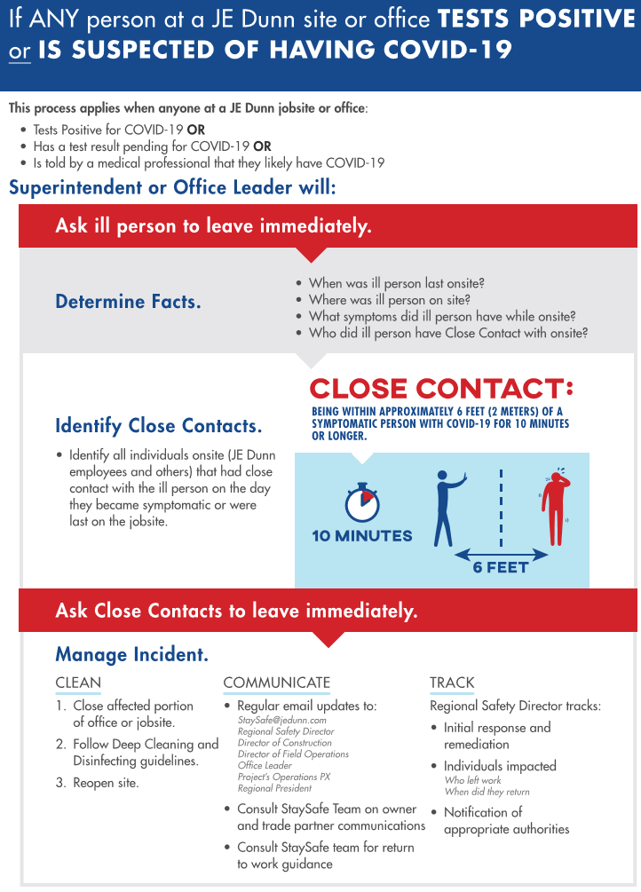
Coronavirus Cases
Confirmed or Suspected
Case

Slide 5
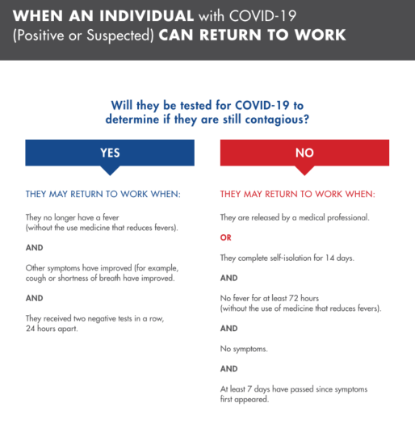
Coronavirus Cases
Returning to Work

Slide 6
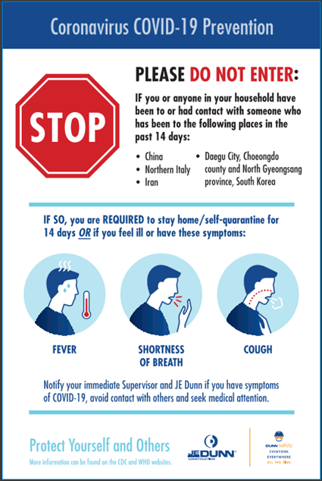
General Requirements
There is currently no vaccine available to protect you against human coronavirus
Transmission is reduced through:
Washing your hands often with soap and water
Avoid touching eyes, nose or mouth with unwashed hands
Avoid close contact with people who are sick
Apply sneezing etiquette: sneeze into tissue and discard immediately in bin with lid; wash hands directly afterwards
  Where no tissue is available, sneeze into your bent elbow
  Minimize body contact such as a handshake
If you are mildly sick, keep yourself hydrated, stay at home and rest!

Slide 7
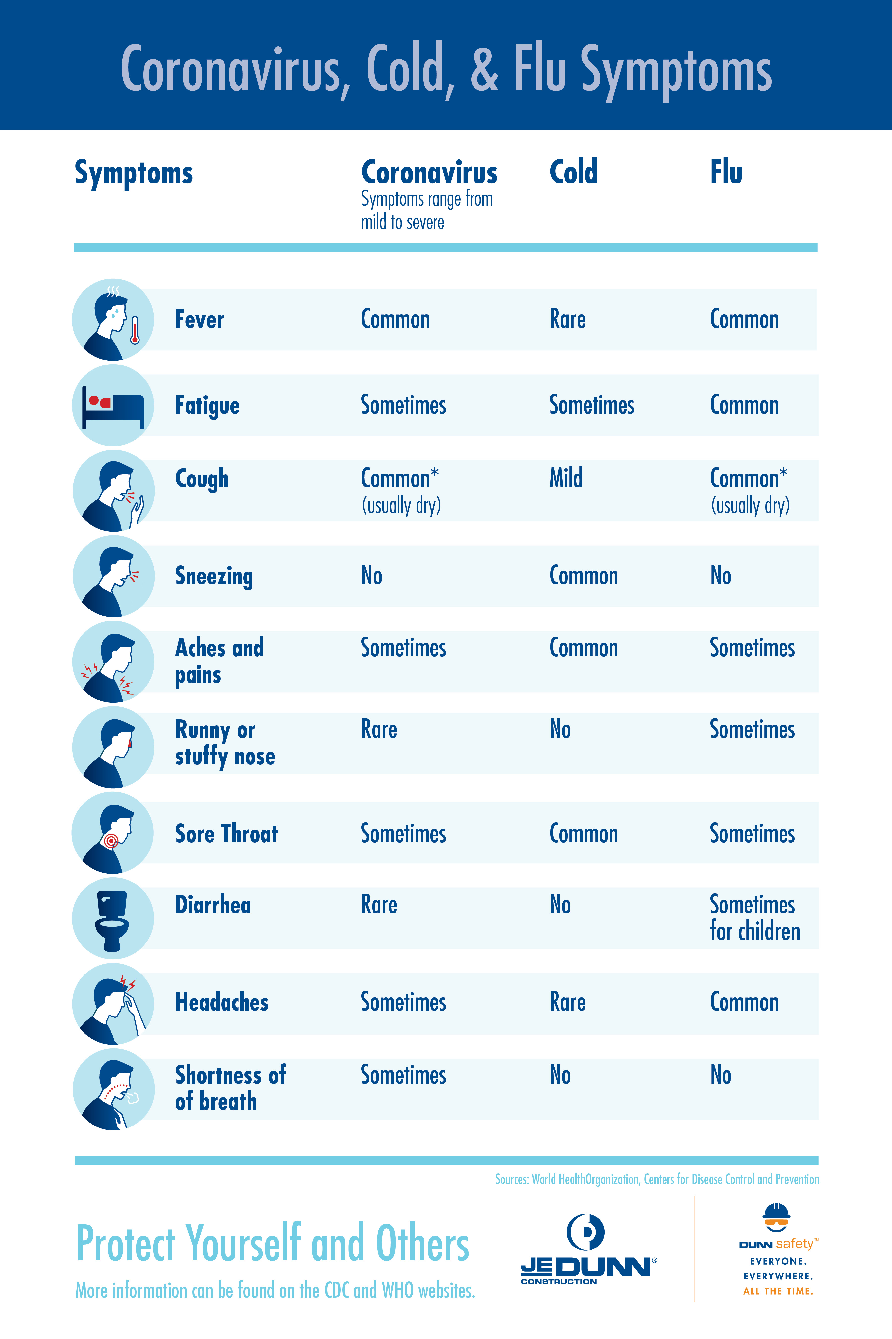
General Requirements
We are all partners in this
Think about symptoms
Do you feel this? Do you see it?
If sick, stay home!

Slide 8
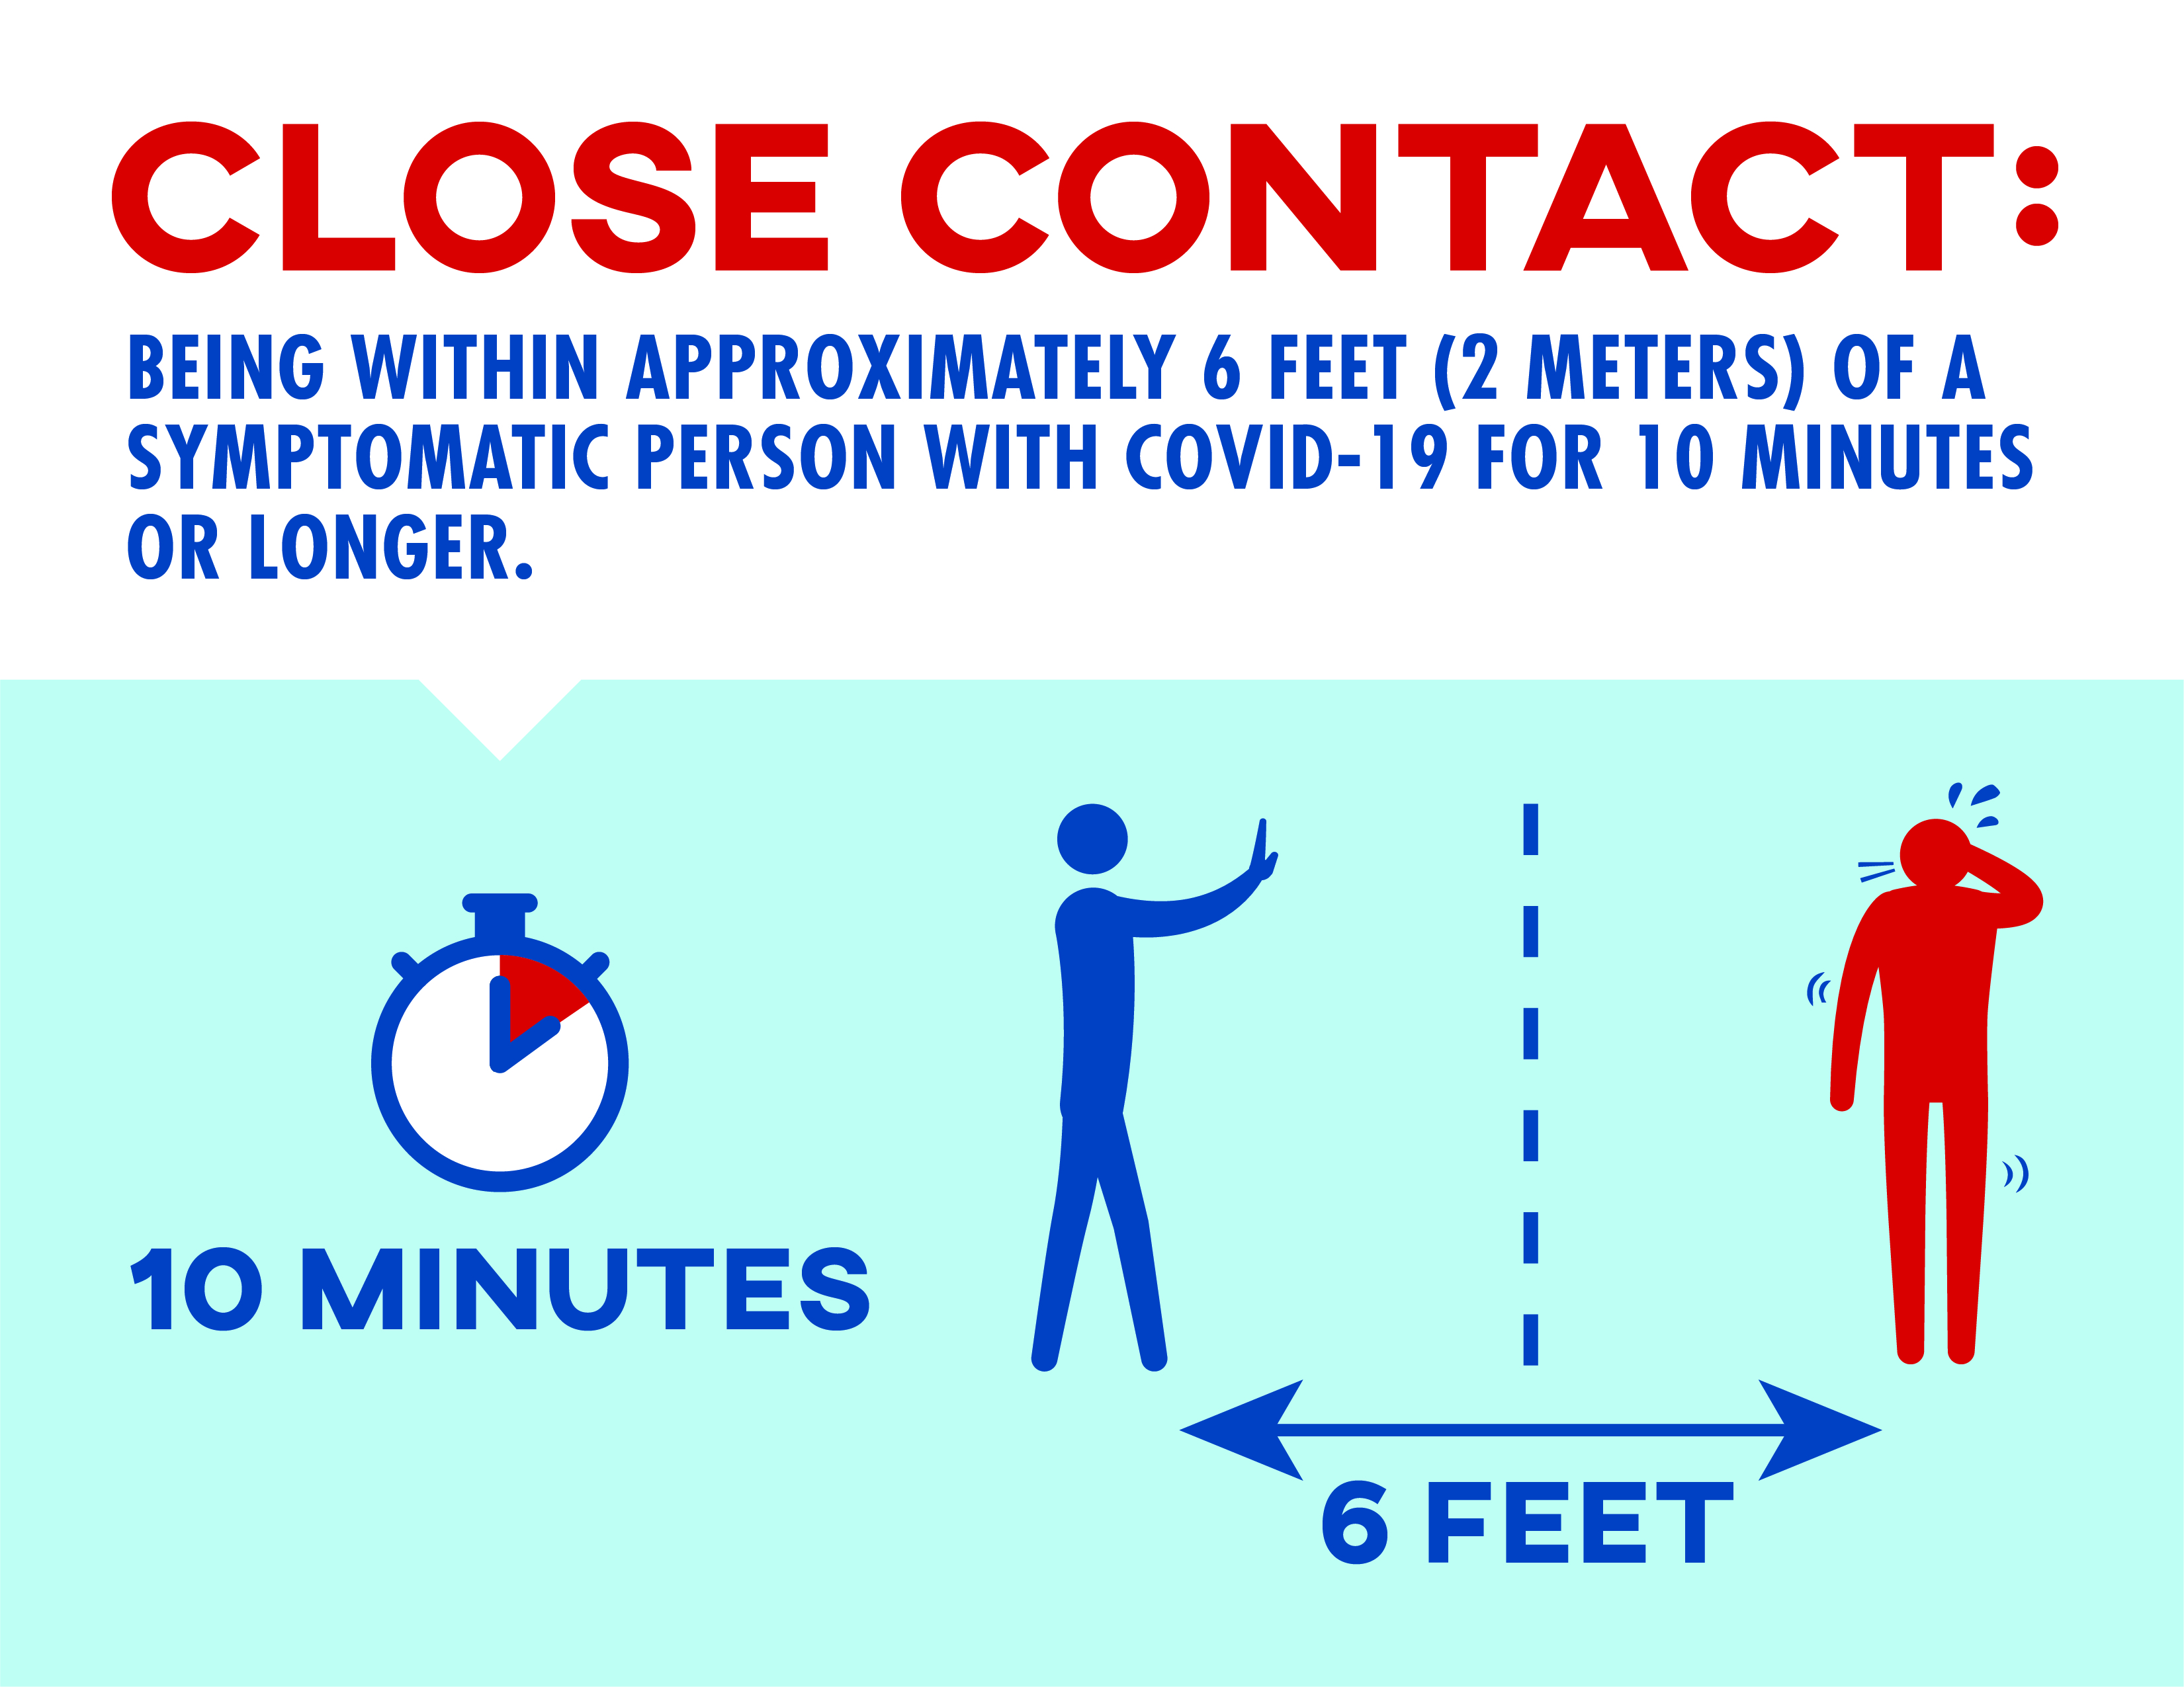
General Requirements
Protect by Social Distancing Yourself from Others

Slide 9

Site Status Update
Site Cleaning and Disinfecting:
Project teams shall schedule Regular Cleaning and Disinfecting.
A full deep clean must be completed when positive COVID-19 case is confirmed.
  JE Dunn has professional services lined up.
Increased thorough cleaning will continue for the foreseeable future
Lunchroom/Lunch considerations (see samples below)
The lunchroom should be reconfigured - to reduce potential virus spread
Prohibit lunch trucks

Slide 10
Site Status Update
Social distancing shall be maintained for all indoor and outdoor gatherings or work activities
Social distancing is defined as maintaining a minimum spacing of 6 ft between individuals.
This will the require the project team to develop area planning and crew sizing.
Travel Restrictions
No international air travel; domestic air travel requires supervisor approval.

Slide 11
Site Entry / Exit Requirements
Employee Screening where required shall follow the JE Dunn screening plan (see Safety Department for Screening guidance)
We understand that this is not a test for the virus – however, it does give a good indication if someone is potentially unwell
If your temperature is >/=100.4 F, do not enter the site and remain at home. Contact your medical provider for direction.

Slide 12
Example: social distancing
Social Distancing Considerations
To provide the safest work environment to all employees, onsite teams should consider options to maintain proper social distancing without an entire work shut down. Teams are already displaying best practice management exercise (i.e., virtual meetings in lieu of face-to-face meetings, staggering breaks and lunch times, eliminating stand downs, etc.). These are all great practices, but to maximize the best approach for all employees, we are considering protocols that ensure proper social distancing.
With a daily workforce of approximately 600-770 employees, teams should consider implementing a 3-shift workforce of 200 employees to 230 employees during each 8-hour shift. This concept allows a full workforce while maintaining proper distances. Teams should consider efforts within the overall facility and avoid focusing teams in congested areas.

Slide 13
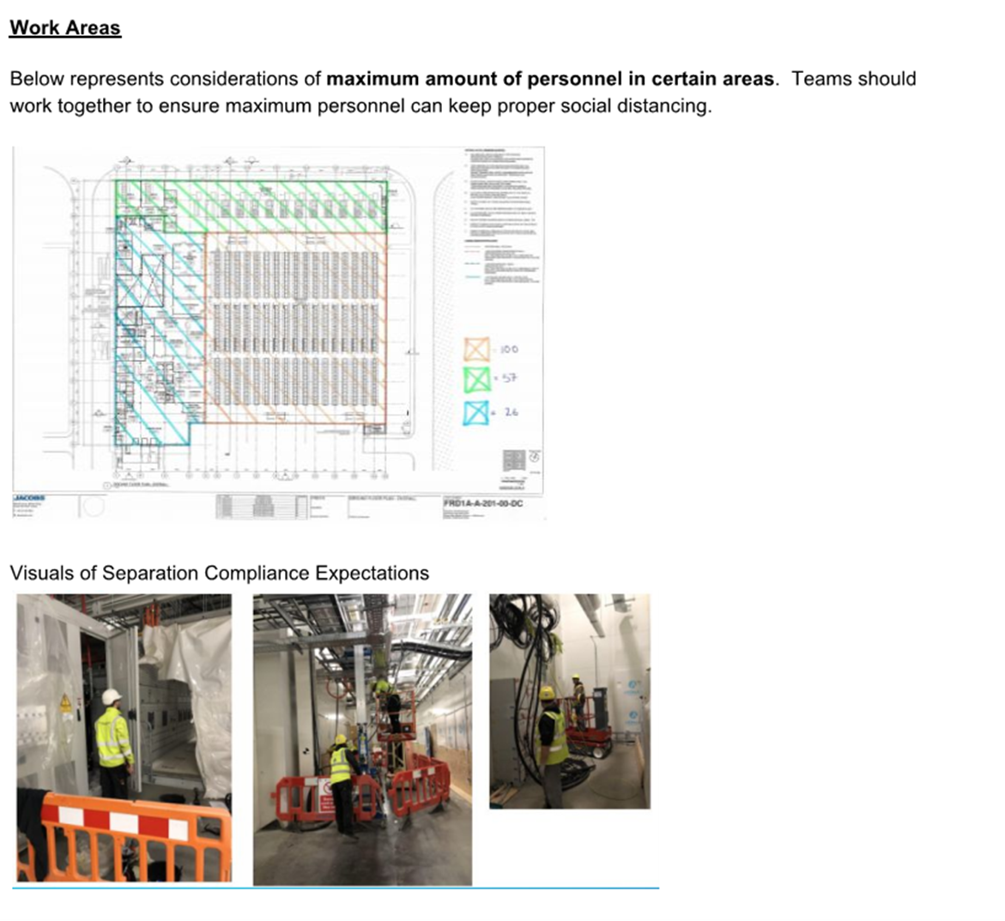
WORK AREAS: achieving proper Social Distancing to best protect personnel
Define # of persons permitted in single area
Provide expectations to trade partners
Monitor conformance

Slide 14
Lunchroom Approaches
  A lunchroom can be re-configured into multiple seating areas to ensure safety
  Consider additional satellite eating areas – add tents, or designate facilities outside of work area(s)
  Consider the maximum lunchroom capacity based on social distancing protocols. Ensure this is facilitated by:
    Dividing the lunchroom into separate lunchrooms
    Staggered breaks
  Sit adjacent instead of directly across from each other
  Respect social distancing
  General on-site hygiene practices apply – wash, rinse, repeat!
  Increased lunchroom cleaning protocols should be deployed. Clean high touch surfaces between groups.
2.0m
2.0m
Seating configuration at each table

Slide 15

Phone Calls are to be used in all cases where possible
Meetings. If on site, the following will apply:
Only half the indicated capacity of the meeting room is permitted. E.g., 10 chairs – only 5 persons allowed. No more than 10 people in any room
There must be at least one seat between every person
Where possible open windows
Meeting to be as short as possible
General hygiene practices to be adhered to

Slide 16
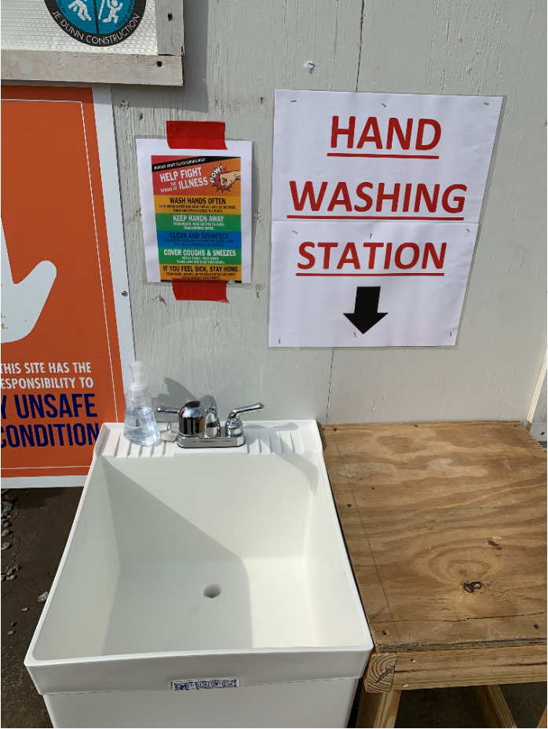
Personal Hygiene
Innovative Hand Washing Station
“Be Creative”

Slide 17
What to do IF….
COVID-19 – Common signs of infection: Respiratory Symptoms; FEVER; COUGH; SHORTNESS OF BREATH/BREATHING DIFFICULTIES
What to do if….You feel ill while on site:
Contact your supervisor via telephone
  Explain your symptoms and discuss your plan to vacate site
Go home
Contact your doctor and follow their guidance
Stay in touch with your supervisor and provide updates on your status
What to do if….You feel unwell before arriving on site:
Stay away from jobsite
Contact your Supervisor and explain your situation
Contact your doctor and follow their guidance
Stay in touch with your supervisor and provide updates on your status
What to do if….Your colleague is showing signs of illness:
Keep your safe distance from the person in question
Ask your colleague to contact his supervisor via telephone
What to do if….You have a high temperature:
Do not enter site
Contact your Supervisor and go home
Contact your doctor and follow their guidance
Stay in touch with your supervisor and provide updates on your status

